Slide 1
StyleCLIP: Text-Driven Manipulation of StyleGAN Imagery (Patashnik, O., Wu, Z., Shechtman, E., Cohen-Or, D., & Lischinski, D. (2021)) RAMI LAB. Sang-Hyun KIM

Slide 2
Contents
Background
StyleGAN2
CLIP
Introduction
StyleCLIP Text-Driven Manipulation
Latent Optimization
Latent Mapper
Global Directions
Comparisons and Evaluation
Conclusions
Q & A

Slide 3
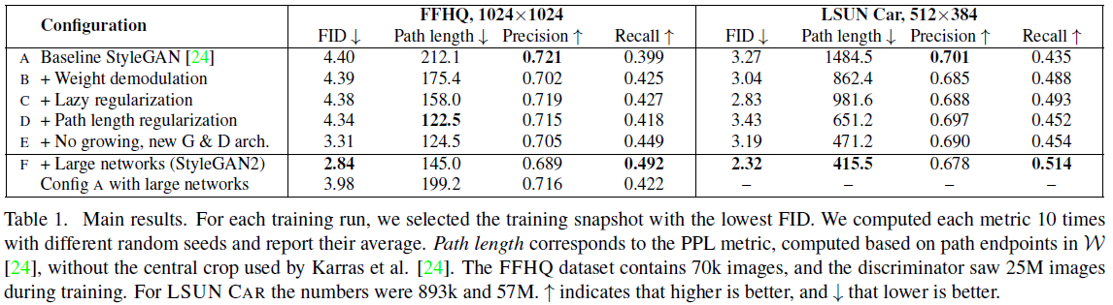
Background
StyleGAN2
StyleGAN을 기반

Slide 4
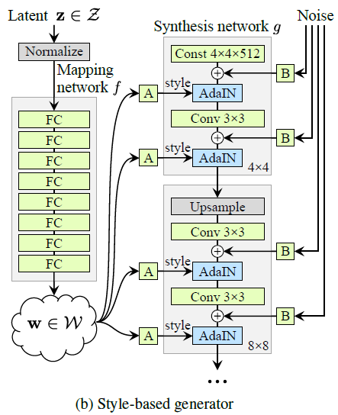
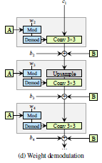
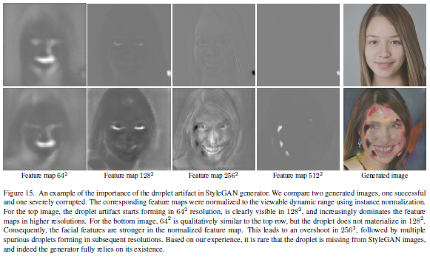
Background
StyleGAN2 (Droplet Artifact)
최종 결과물에 물방울 무늬 같은 noise가 반복해서 나타나는 현상.

Slide 5
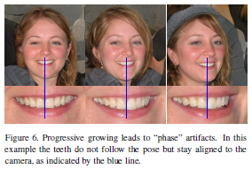
Background
StyleGAN2 (Phase artifact)
이빨이나 눈동자 같이 detail 한 부분에서 disentanglment 가 자연스럽지 않은 현상.

Slide 6
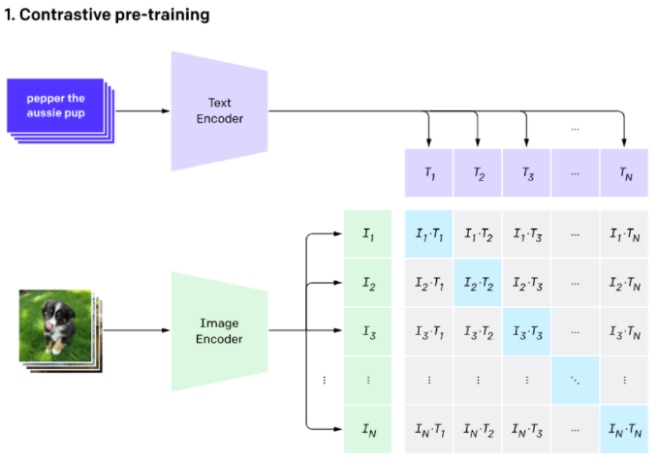
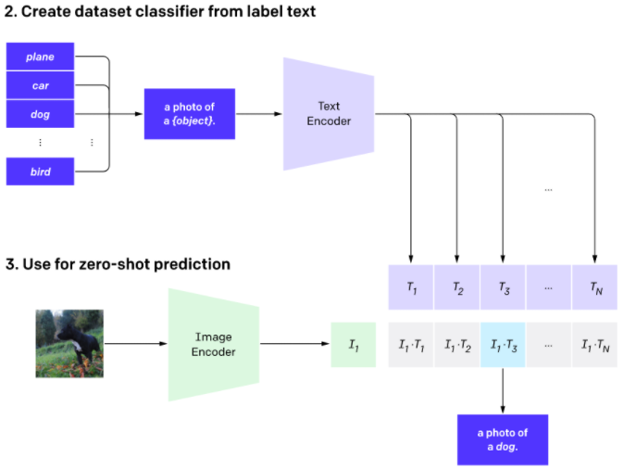
Background
CLIP ( Contrastive Language-Image Pre-training )

Slide 7
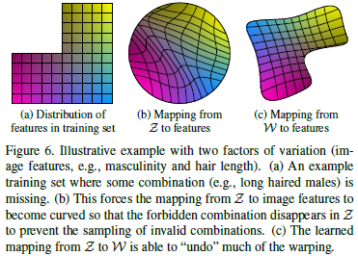
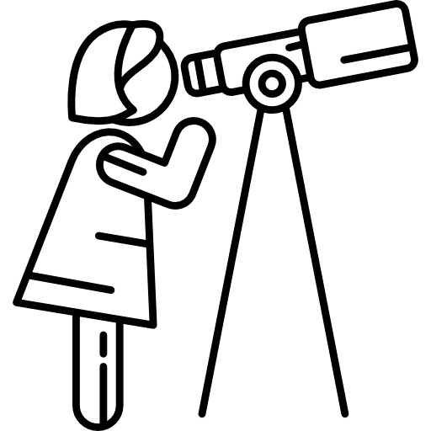
Introduction
StyleGAN의 disentangl한 latent space를 사용해서 image manipulation.
Problem
Latent vector를 찾기 위한 수동적인 방법.
Solution: StyleCLIP
그림 출처: https://www.pngwing.com/ko/free-png-ptovd

Slide 8
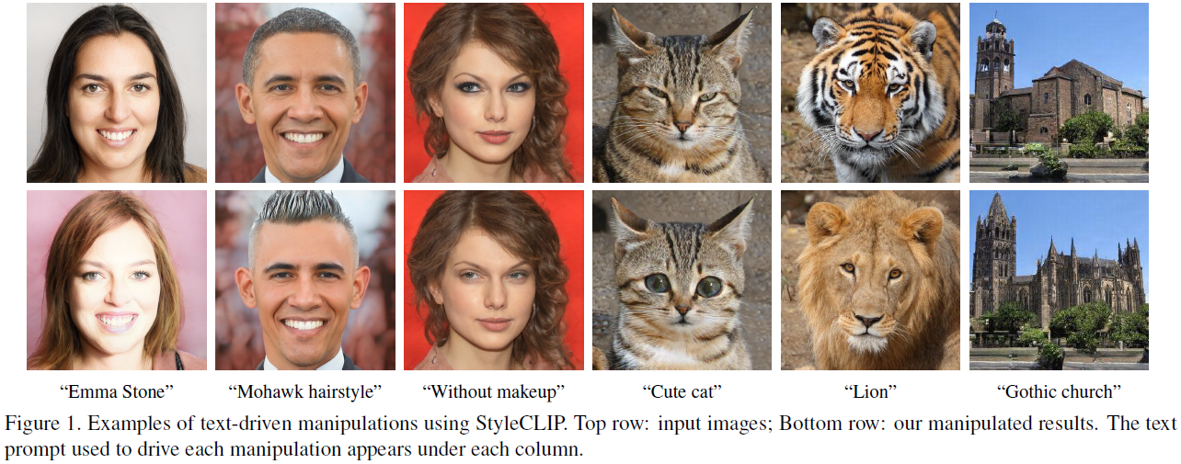
Introduction

Slide 9
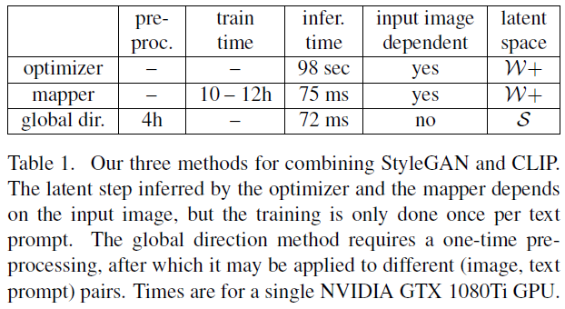
StyleCLIP Text-Driven Manipulation
In this paper, they investigate three techniques that combine CLIP with StyleGAN.
Text-guided latent optimization, where a CLIP model is used as a loss network. This is the most versatile approach, but it requires a few minutes of optimization to apply a manipulation to an image.
A latent residual mapper, trained for a specific text prompt. Given a starting point in latent space (the input image to be manipulated), the mapper yields a local step in latent space.
A method for mapping a text prompt into an input-agnostic (global) direction in StyleGAN’s style space, providing control over the manipulation strength as well as the degree of disentanglement.

Slide 10
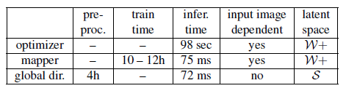
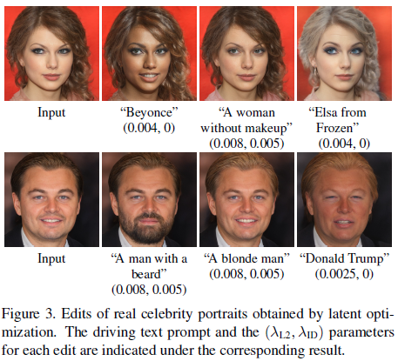
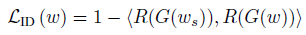
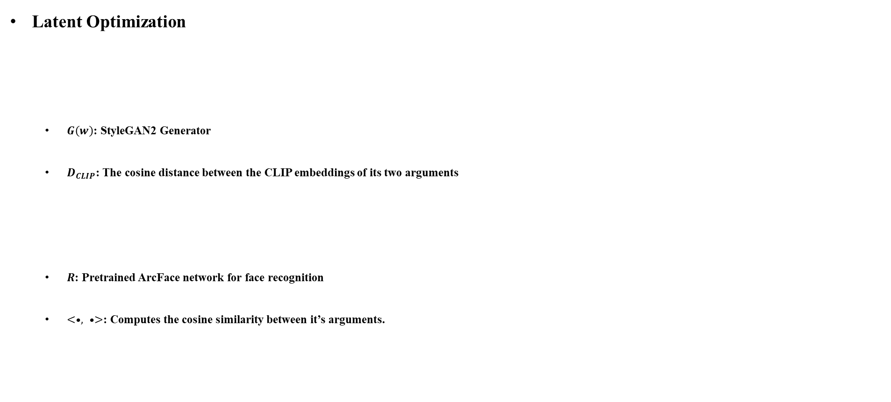
Method
Latent Optimization
$G\left(w\right)$: StyleGAN2 Generator
$D_{CLIP}$: The cosine distance between the CLIP embeddings of its two arguments
$R$: Pretrained ArcFace network for face recognition
$<•, •>$: Computes the cosine similarity between it’s arguments.

Slide 11
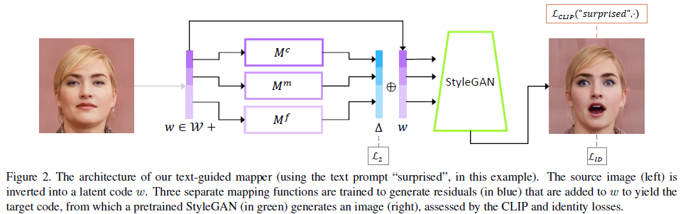
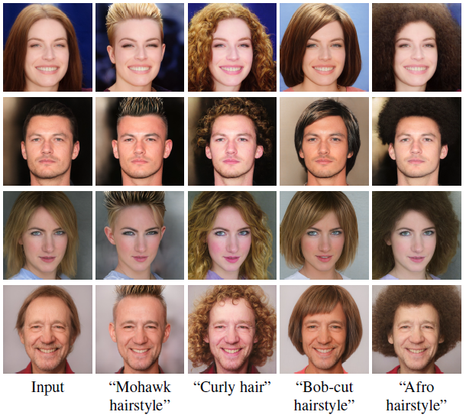
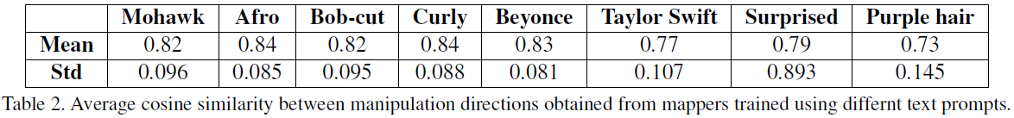
Method
Latent Mapper
Latent code of the input image.
One can choose to train only a subset of the three mappers.
Loss

Slide 12
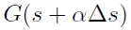
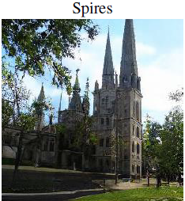
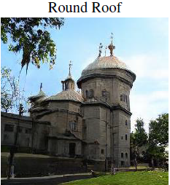
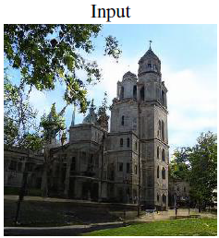
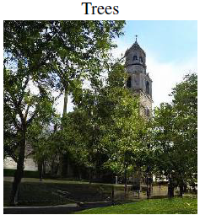
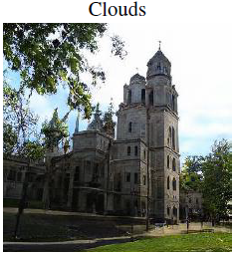
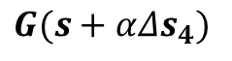
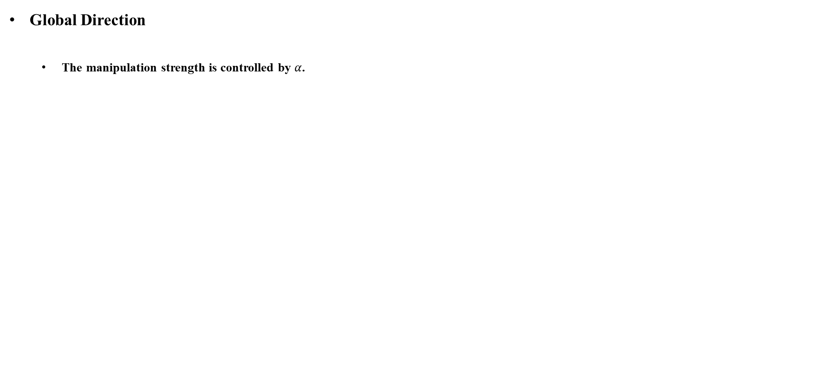
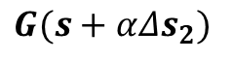

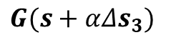
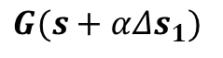
Method
Global Direction
The manipulation strength is controlled by $α$.
$$G(s+αΔs_{1})$$
$$G(s+αΔs_{2})$$
$$G(s)$$
$$G(s+αΔs_{3})$$
$$G(s+αΔs_{4})$$

Slide 13
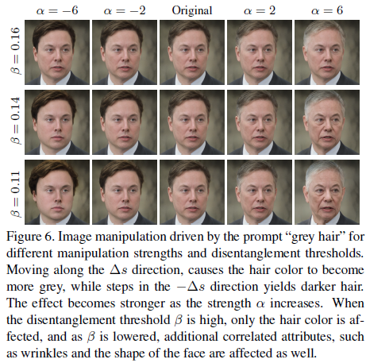
Method
Global Direction
Parameter β may be used to control the degree of disentanglement in the manipulation.
Using higher threshold values results in more disentangled manipulations.
But at the same time the visual effect of the manipulation is reduced.

Slide 14
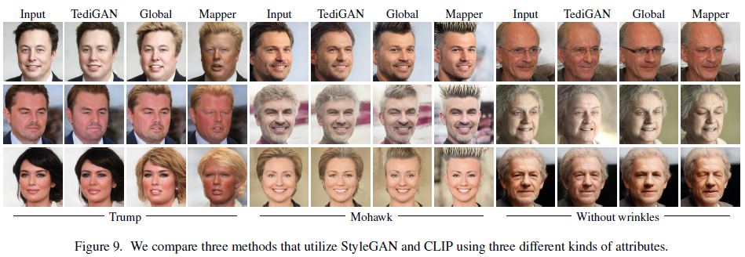
Comparisons and Evaluation

Slide 15
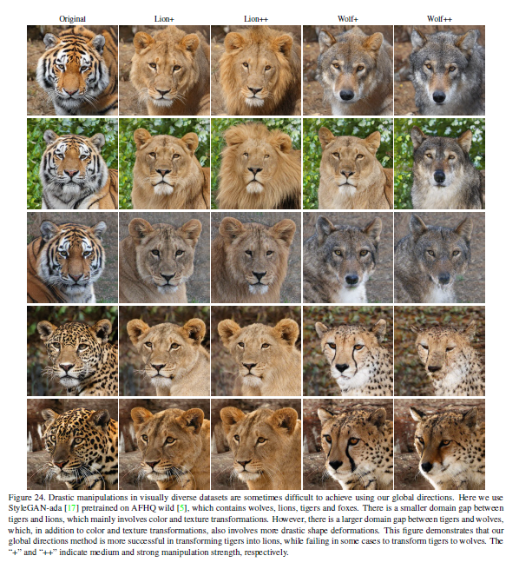
Limitations
The methods rely on a pretrained Style-GAN generator and CLIP model for a joint language-vision embedding.
Drastic manipulations in visually diverse datasets are difficult to achieve.

Slide 16
Conclusion
Propose three methods that bridge the gap between the latent space of StyleGAN and CLIP to realize text-driven image manipulation.
Introduce an optimization method that utilizes a CLIP-based loss.
Introduce a latent mapper that infers a text-guided latent manipulation.
Present a method for mapping text prompts to input-agnostic global directions.

Slide 17
Reference
StyleGAN: https://arxiv.org/abs/1812.04948
CLIP: https://openai.com/blog/clip

Slide 18
Q & A

